Slide 1
Enteric Coating:
Benefits of Protecting your Product

Slide 2
Enteric Coating:
Protecting your Product
Why Enteric Coating?
Benefits of Enteric Coating
Evidence that Enteric Coating Works

Slide 3
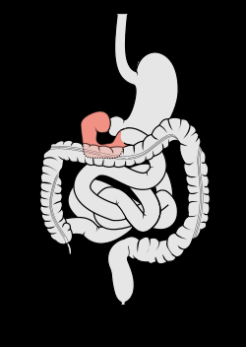
Why Enteric Coating?
Our digestive system contains very harsh conditions that enable it to break down food efficiently.

Slide 4
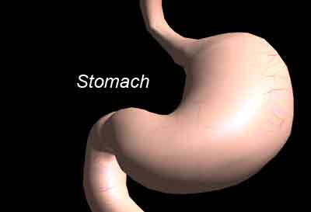
Why Enteric Coating?
When we take a typical supplement:
The capsule or tablet is swallowed and travels down the esophagus to the stomach.
In the stomach the tablet or capsule is churned and gyrated in highly acidic digestive secretions, pH 1-4, for 45 minutes to 2 hours.
If there is anything left of the tablet or capsule, it will be passed through the duodenum to the small intestine.
Highly Acidic Environment

Slide 5
Why Enteric Coating?
What happens to uncoated tablets and capsules?
Stomach acid breaks down tablets and capsules to release active ingredients (enzymes).
The highly acidic environment of the stomach destroys the majority of the enzymes’ activities.
If the tablet is of poor quality (contains binders and fillers) the product may pass through both the stomach and intestine with no absorption.

Slide 6
Notice Enzyme Activity in Harsh Stomach Conditions (pH 1-4)

Slide 7
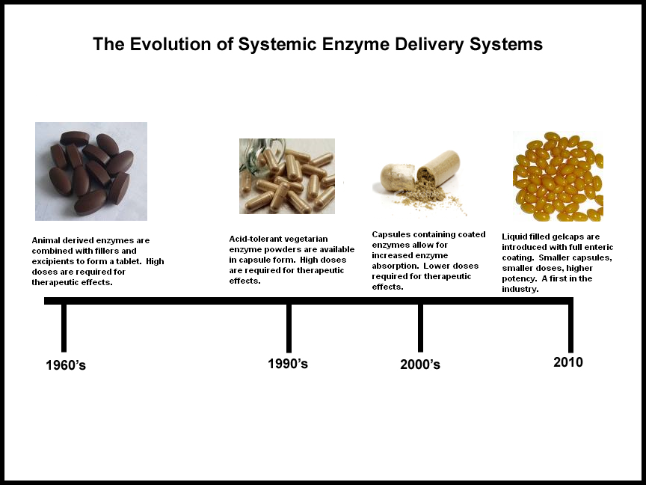
What led to Enteric Coating:

Slide 8
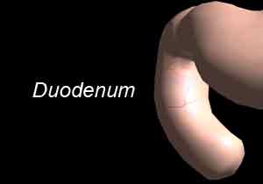
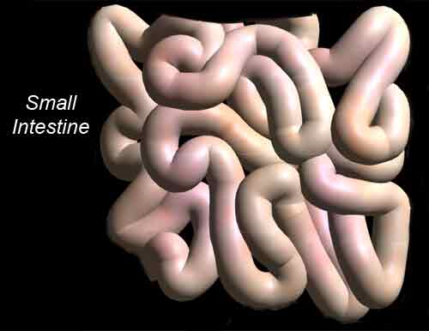
Benefits of Enteric Coating
Protects capsule or tablet from acidic environments of stomach
After passing through the stomach allows capsule or tablet to break down easily in the Duodenum* (pH 6-8)
Enables absorption of enzymes, at their highest activity levels, in the small intestine
* (approximately 1st 10” of small intestine)

Slide 9
Proof that Enteric Coating Works
Conducted “Disintegration Tests (Enteric Coated Capsules)” following procedures from Japanese Pharmacopeia (General Tests, 15th Edition)
  Two Test Conditions
    First test simulates gastric fluid (harsh stomach conditions):
      pH 1.2 for 120 minutes at 37 °C (98.6 ° F)
    Second test simulates intestinal fluid (duodenum):
      pH 6.8 for 60 minutes at 37 °C (98.6 ° F)
  Test Results
    Stomach Conditions – Capsules did not disintegrate
    Intestinal (duodenum) Conditions – Capsules disintegrated completely

Slide 10
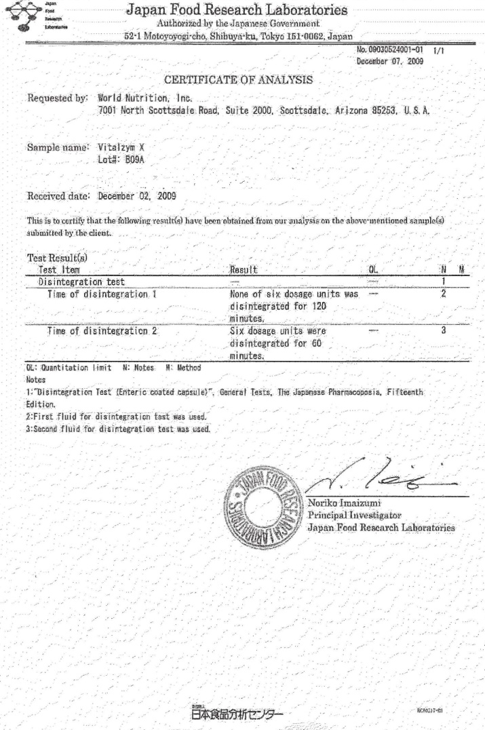
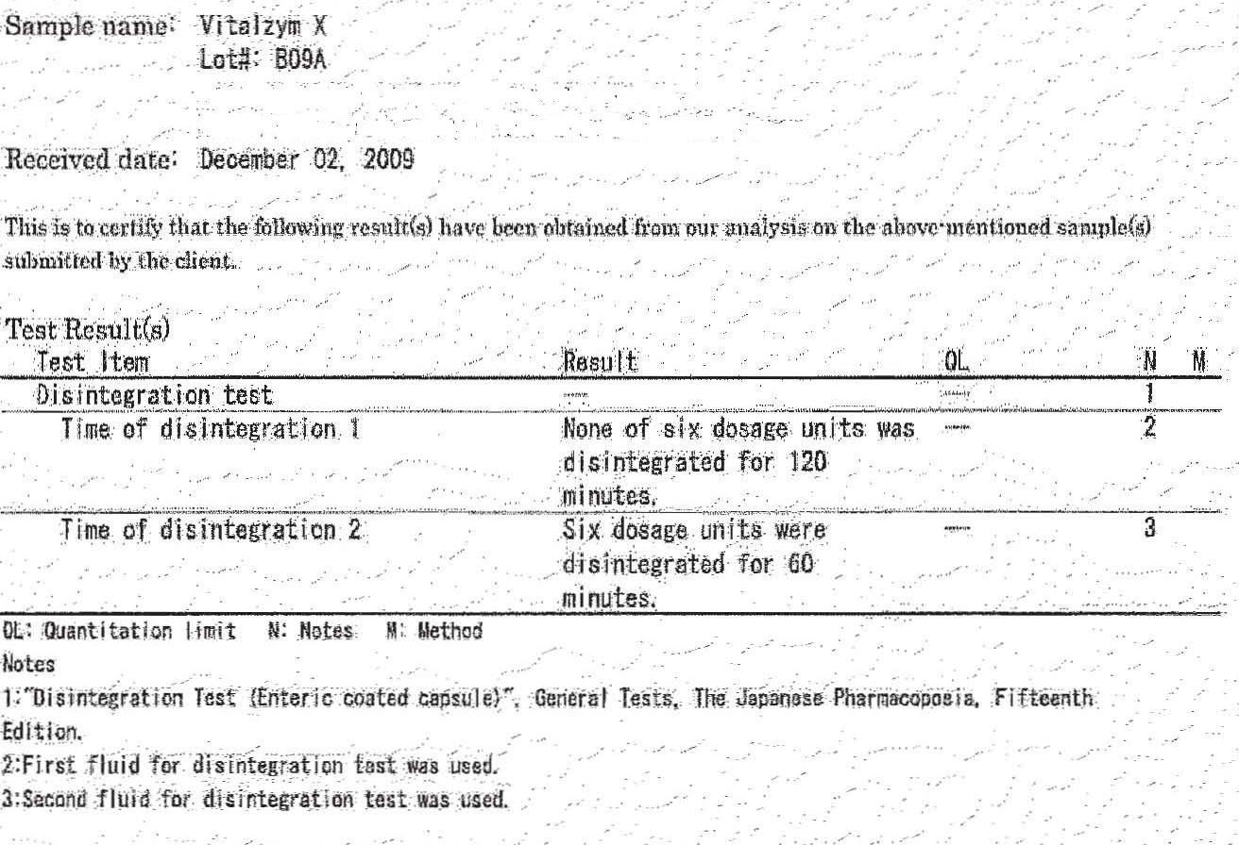
Proof that Enteric Coating Works
Certificate of Analysis
Highlighted Area

Slide 11
Benefits of Enteric Coating:
Summary
Uncoated Capsules and Tablets lose the effectiveness of their enzymes when passing through the stomach
Enteric Coating protects a capsule’s contents in highly acidic environments: Stomach
Enteric Coating breaks down completely in neutral pH environments: Duodenum
Enteric Coating enables delivery of enzymes for absorption with maximum activity intact: Small Intestine

